Slide 1

MIT WPU
FIRST YEAR M.TECH
VlSI & Embedded Systems
Subject:- Artificial Intelligence Techniques and Applications
TOPIC:- Face Recognition and Emotional Detection
Guide : Prof . Vinaya Gohokar
Name & PRN NO: 1. Arush Nyayadhish (1262243370)
2. Afnan FAROOQ pandith (1262240356)

Slide 2
Problem Statement
Algorithm Flowchart
Methodology
Working
Advantages
Future Scope
Data Sets
Conclusion
References

Slide 3
Problem Statement :
. The Emotions Of Human Beings Are Measure Part In Our Day to Day
Life.
. It is Very Hard To Find Inner Emotions Using any method. There is none other than Computer Vision.
. Sometimes Human Beings Are Very Introvert Related to Sharing their
inner feelings and you cannot detect that.
. To Find Emotions for Self Analysis Require Some Basics
Or Advance System in order analyze them and give approximate or related solutions.

Slide 4
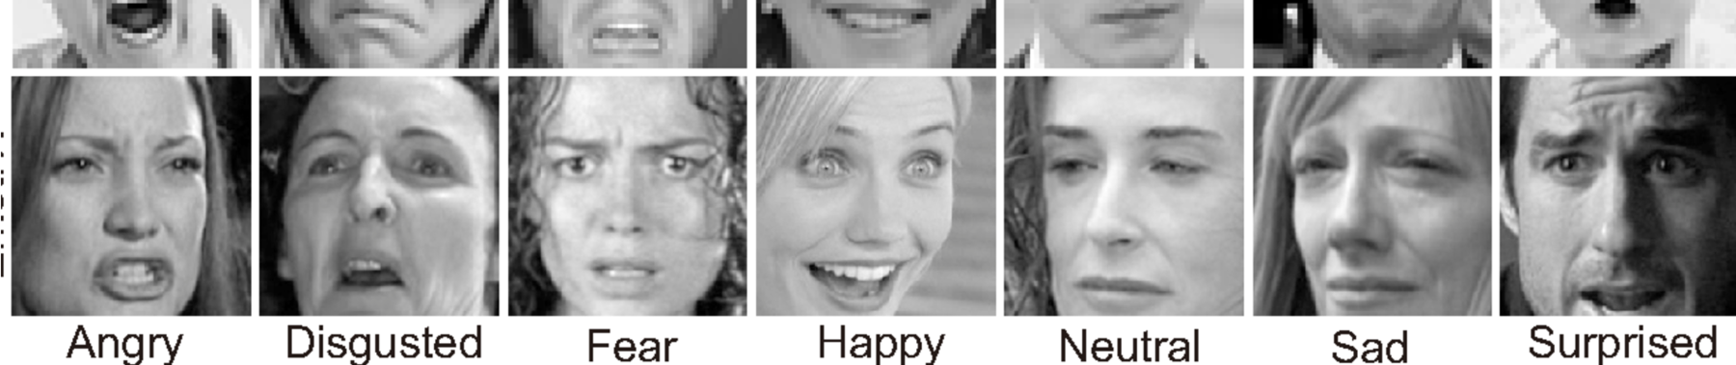
The images are based on the database generated for detection of facial expression of human beings here:- Angry =0 , Disgusted = 1, Fear =2, Happy =3, Neutral = 4, Sad = 5, Surprised =6 These are annotations used for the face detection or detection of emotion.

Slide 5
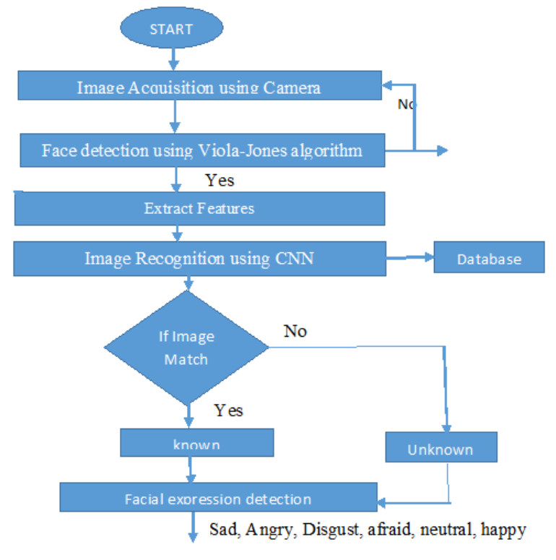

Slide 6
Methodology :
1. The Algorithm Analyzes a Grayscale Image By Moving a Sliding Window Over it and looking For Specific Features in Each Window.
2. If a Classifier Outputs “No Face Detected", Then The Window is considered to Not Contain a Face. If All Classifiers Output “Face Detected", Then The Window Is Considered to Contain A Face.
3. Normalize the face, ensuring that facial landmarks (e.g., eyes, nose, mouth) are properly aligned. This step improves recognition accuracy.
Dlib Library:
Uses machine learning techniques to detect 68 key facial landmarks and align the face by warping it so the eyes and mouth are in predefined positions. Facial Landmark Detection with CNNs: Deep learning models trained on labeled facial points can detect key landmarks with higher accuracy.

Slide 7
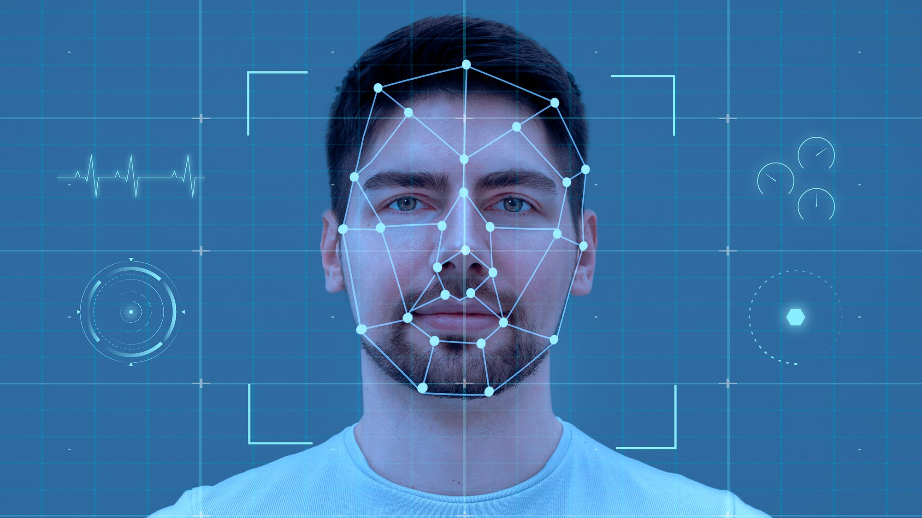
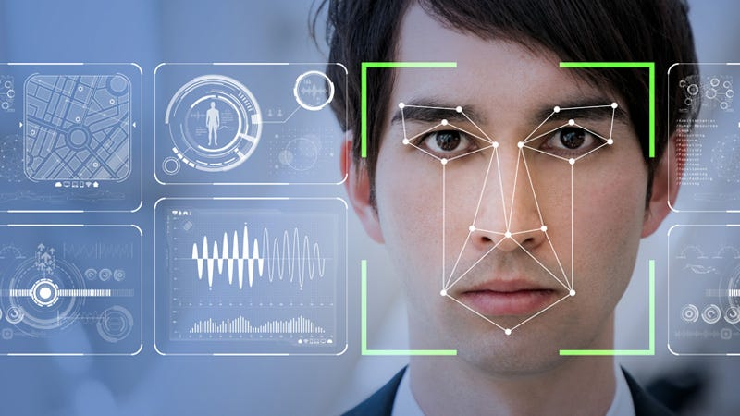

Slide 8
Working
Detection:
AI algorithms detect a face in an image or video.
Alignment:
The detected face is aligned and normalized to improve accuracy.
Encoding:
The face is encoded into numerical vectors that represent unique facial features.
Comparison:
Encoded faces are compared against stored encodings in a database for identification.
Emotion Detection:
Uses models trained on datasets of facial expressions.
AI analyzes specific features (e.g., eye movement, mouth curvature, furrowed brows).
Maps detected expressions to predefined emotions (e.g., happiness, sadness, anger, surprise, fear, etc.).

Slide 9

Advantages
1. Access Control:
AI-based facial recognition can be used for secure access to devices, buildings, or sensitive information, replacing passwords or physical keys​
2.​ Surveillance:
It helps in identifying individuals in real-time for security purposes, such as in airports, public events, or high-risk zones​.
3. Efficiency and Speed
AI systems process facial data quickly, enabling rapid identification and verification, which is crucial for time- sensitive applications like law enforcement and emergency responses​
4 Non-Intrusive Identification
Unlike fingerprinting or retinal scans, facial recognition does not require physical interaction, providing a seamless and hygienic authentication experience​.
5. Integration with Existing Systems
Facial recognition can be easily integrated with other security systems, enhancing their functionality without the need for extensive additional hardware​.
6. Improved User Experience
It allows for personalized services, such as targeted advertising or tailored content delivery in retail or entertainment

Slide 10
Future Scope :
1. Security and Surveillance increased Use in Public and Private Security:
Facial recognition is expected to play a larger role in public surveillance, crime prevention, and security in sensitive areas like airports, malls, or large events. It can help in identifying criminals or missing persons. Access Control and Authentication: The use of facial recognition for secure logins, such as in smartphones or computers, will continue to expand in both consumer and business sectors. It's also likely to replace traditional security systems like keycards in office buildings.
2. Retail and Customer Experience personalized Marketing:
Retailers may use facial recognition to identify customers and tailor personalized experiences, such as product recommendations or special offers based on the shopper's preferences. Seamless Transactions: Some businesses may introduce "face pay" technology, allowing customers to pay by simply showing their face.
3.Healthcare and Well-being Patient Monitoring:
Facial recognition could be used in healthcare settings for patient identification, streamlining administrative processes, and preventing identity theft. AI-powered facial recognition can also help monitor patient conditions, such as detecting early signs of pain or stress. Diagnosis of Genetic or Psychological Conditions: AI can analyze facial features to detect potential signs of genetic disorders (such as Down syndrome) or emotional states, which could be useful in diagnosing psychological conditions.

Slide 11
Datasets for Facial Recognition and Emotional Detection
FER2013 Dataset:
Contains approximately 30,000 grayscale 48x48 pixel images categorized into seven emotion classes: angry, disgust, fear, happy, sad, surprise, and neutral. It's a commonly used benchmark dataset for facial emotion recognition tasks. Available on platforms like Kaggle and PapersWithCode
JAFFE (Japanese Female Facial Expression):
Includes 213 images of facial expressions from 10 Japanese women, labeled for six basic emotions and neutral. It's suitable for small-scale experiments in emotion recognition​

Slide 12
Conclusion:-
In conclusion, facial recognition using AI holds immense potential to transform industries like security, retail, healthcare, and entertainment by enabling more efficient, personalized, and secure systems. Its applications can significantly enhance convenience and safety in both public and private sectors, from seamless authentication to improved law enforcement and healthcare services.
However, the technology comes with critical ethical and privacy concerns. Issues such as data security, bias, misuse, and potential for mass surveillance need to be addressed through stringent regulations, transparency, and responsible development practices. Ensuring user consent, improving algorithm fairness, and safeguarding personal data will be key to ensuring the technology is used ethically and equitably.
As facial recognition continues to evolve, its success will depend on striking a balance between innovation and respecting privacy, ethics, and fairness in a rapidly digitizing world.

Slide 13
References:-
Kaggle Link: FER2013 Dataset on Kaggle
https://huggingface.co/datasets/TrainingDataPro/facial-emotion-recognition-dataset

Slide 14
THANKS

